Slide 1


Slide 2
Online Pharmacy Portal
Project by: Gayatri Sravani Akella
Soujanya Akella
Chahnitha Chandu
Nikithanjali Dodla

Slide 3

Description
The proposed plan is to create a web page where a user can buy medicines and other pharmacy products online.
The page consists of
Login page
Admin page
Customer page
Registration page

Slide 4
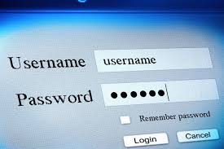
Login Page
The login page is also the home page.
Each user, either admin or customer has to provide username and password to login.
Also has a button for new users to register.

Slide 5
Admin Page
The admin is the person who manages the website.
Operations and functionalities include:
Notification for every order
Accept/reject orders, generate FedEx tracking number
Add medicines in database
Update medicines count to reflect correct availability
Delete any medicines we do not sell anymore

Slide 6
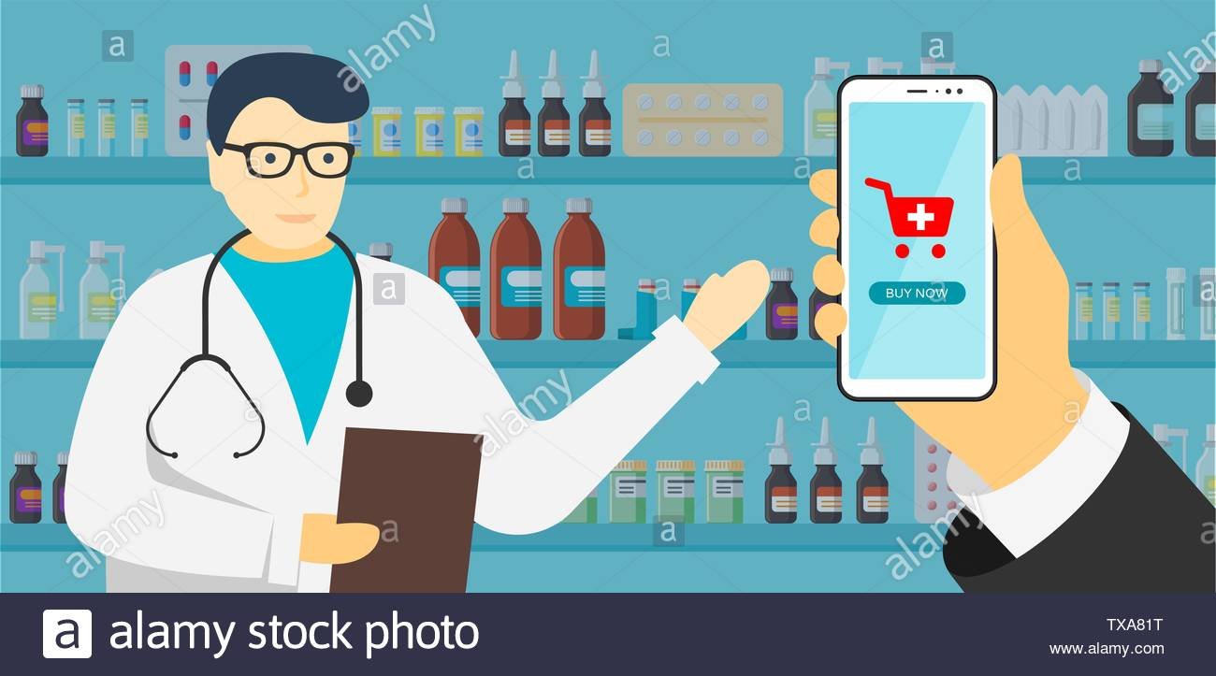

Slide 7
User Page
The user page or the customer page is where the medicines can be ordered and bought.
Functionalities include
Search bar for “over the counter” medicines
Search bar to directly look for a particular drug
Cart to see what all we have added
Redirection to payment page

Slide 8


Slide 9

Registration Page
In this page all new users can register themselves as customers of Med-AnyTime.
To register they need to provide:
Full name
Government Id
Date of Birth/ Age
Email-Id
Phone Number

Slide 10
Requirements & Specifications
Languages Used: PhP, Bootstrap, CSS, Sql
Server Used: XAMPP
Development Environment: Visual Studio Code

Slide 11
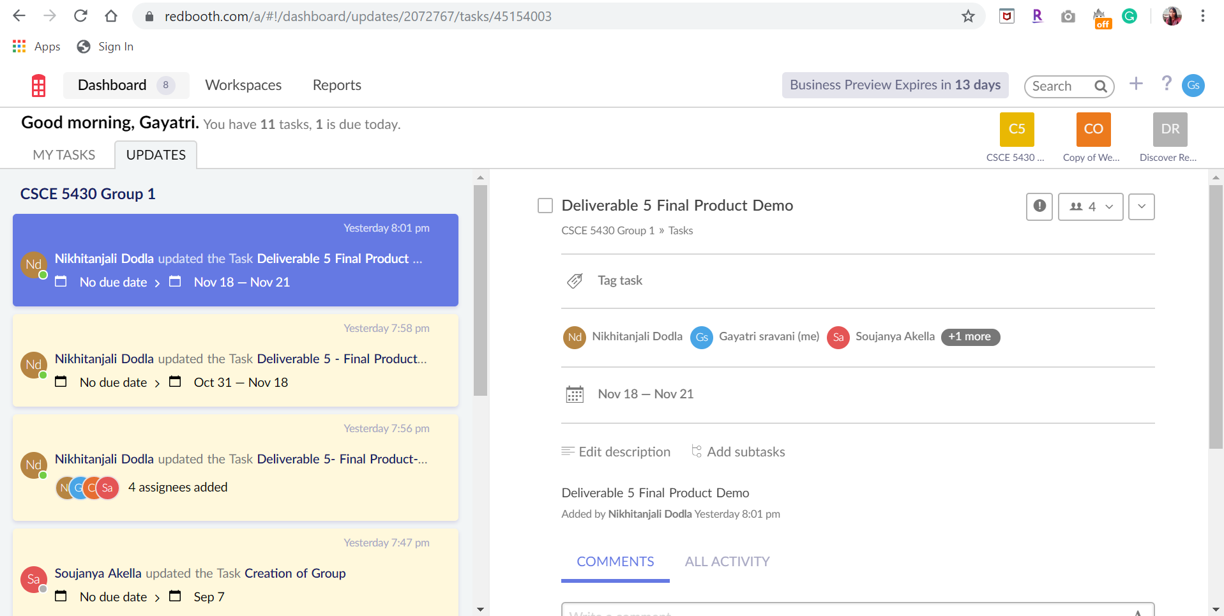
Project Management Tool : Redbooth

Slide 12
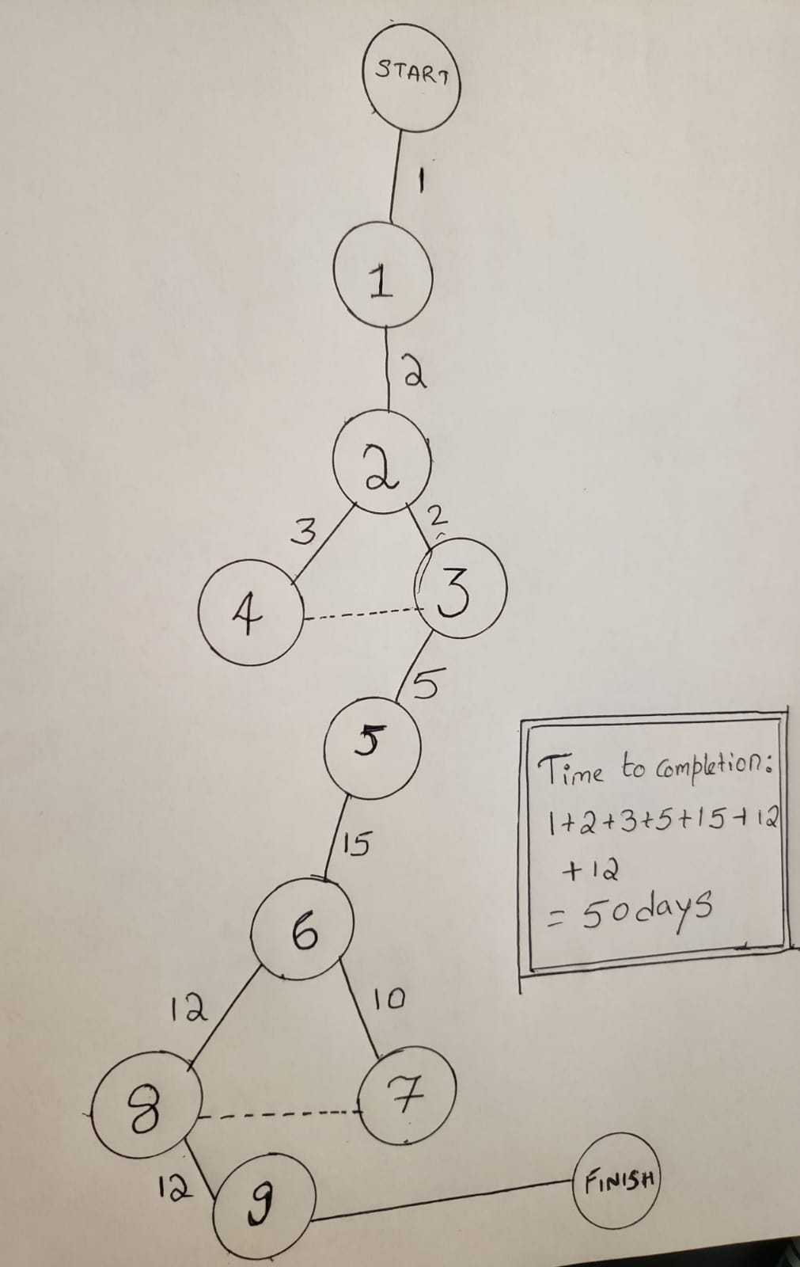
PERT CHART
Taking into account all the components that need to be designed and added to the webpage, we have identified 9 major Tasks, each having a bunch of Sub-tasks.
As per plan, we require 50 days for the completion of the tasks. Hence we are confident that our team will be able to deliver the product on time.

Slide 13
RISKS
Medicine Returns:
Considering the sensitivity and nature of articles being sold by us, if any item is returned we may not be able to sell it to another person again.
User Security:
Each account is associated with a login id and password. There is a possibility that accounts can be hacked, either the user account of admin account.

Slide 14
RISKS (Contd…)
Fake Identity:
In accordance to the FERPA law, certain drugs are not being sold without a id proof. But, there is no way to be sure that the order was placed by the same person whose ID is being provided. It can be the case wherein an identity was stolen.

Slide 15
Contingency Plan
Medicine Returns:
Any medicine that already been delivered cannot be returned. Similarly, an order can be rejected at the time of delivery either because the medicine was not what was ordered or expired product is delivered. An order can be cancelled before it is shipped or delivered.

Slide 16
Contingency Plan (Contd…)
User Security:
Just to ensure security, any kind of important activity will prompt an email to the user’s / admin’s account. This will ensure that the account holder can take control as soon as the first suspicious activity is observed.

Slide 17
Contingency Plan (Contd…)
Fake Identity:
Just like in case of user account security, every time an Id is provided online, a mail is sent to the concerning party. Also, drugs that fall under the FERPA law will be delivered in person by one of our own, only to the person whose ID was provided.

Slide 18
Roles and Responsibilities
Front- End Development : Nikhitanjali and Chahnitha
Database Connections and Table Creation: Gayatri sravani and Soujanya
Login/Logout Logic: Nikhitanjali and Soujanya
Cart Functionality: Gayatri and Chahnitha
Testing will be equally divided between all 4 of us

Slide 19


Slide 20


